Slide 1
Analyzing Chemistry-Related YouTube Channels
This project uses YouTube APIs to gather data on the most popular Chemistry-Based Channels on YouTube.
We analyze metrics like their view counts, subscriber counts, and video counts.
We explore what it takes to be a successful Chemistry Channel on YouTube.
Instructions for running the script as well as the full project code can be found on my GitHub.

Slide 2
Part 1: Top Chemistry-Related Channels

Slide 3
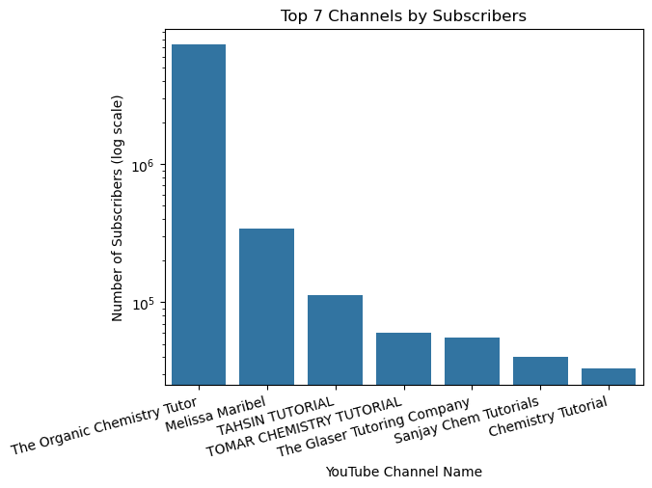
Which Chemistry channels have the most subscribers?
The graph displays the top 7 Chemistry-related Channels on YouTube by subscribers
The Organic Chemistry Tutor has the most subscribers by a long shot, at ~ 7.27 million.
At the bottom of this top 7 is the Chemistry Tutorial (~33k subscribers).
The Organic Chemistry Tutor must be doing something right. Let’s keep looking…

Slide 4
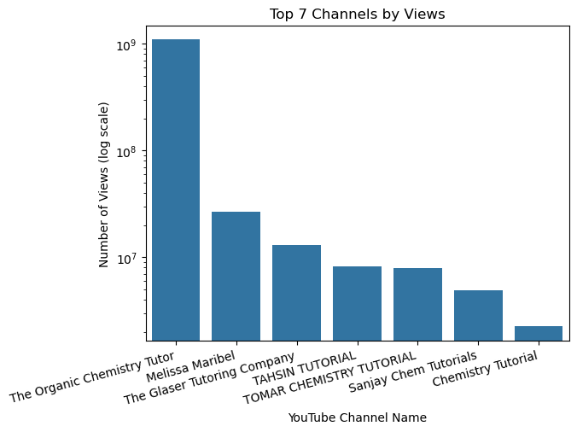
Which Chemistry Channels have the most views?
The same 7 YouTube Channels have the most subscribers and the most views, although their orders vary slightly.
The Organic Chemistry Tutor = most views AND subscribers, by far.
Melissa Maribel = 2nd from the top for both views and subscribers.
The Glaser Tutoring Company has fewer subscribers than Tahsin Tutorial and Tomar Chemistry Tutorial, BUT Glaser has MORE VIEWS than them both.
Chemistry Tutorial channel = bottom of top 7, for both views and subscribers.
Subscribers and views seem to be correlated - the more subscribers a channel has, the more views.
The exception to this subscribers/views trend is Glaser Tutoring Company.

Slide 5
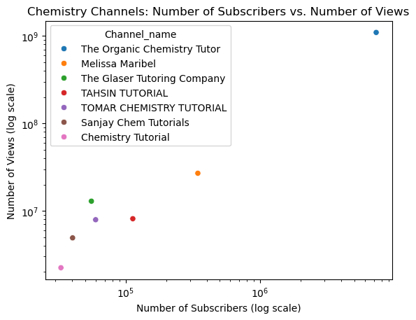
Are Subscribers and Views correlated for Chemistry Channels?
Subscribers and Views seem to be highly correlated, with correlation coefficient r = 0.9997
This makes sense
Would need statistical testing to see if correlation is statisti-cally significant.

Slide 6
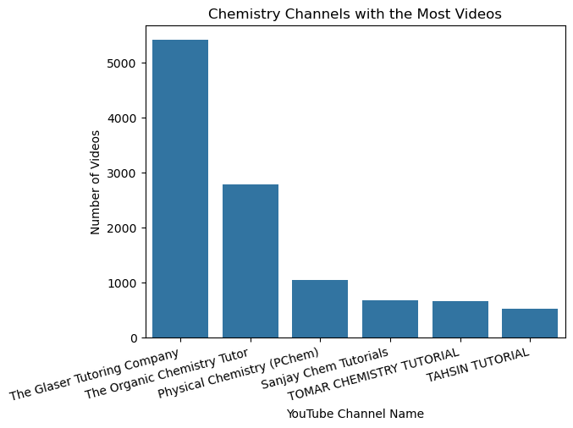
Which Chemistry Channels have the most Videos?
It seems that video count is NOT correlated with view and subscriber count.
The Organic Chemistry Tutor = 1/2 as many videos as The Glaser Tutoring Company, yet 85x more VIEWS and 130x more SUBSCRIBERS.
Melissa Maribel =/= top 6 channels with most VIDEOS (268), BUT more VIEWS and more SUBSCRIBERS than all channels with 500 - 1000 videos. Good for her.
Physical Chemistry (PChem) > 1000 videos (3rd most) but =/= top 7 for most VIEWS or most SUBSCRIBERS.
Thus, num of videos <-> popularity
If quantity of videos doesn’t appear correlated with subscriber or view counts, then it must be another factor making The Organic Chemistry Tutor and Melissa Maribel so successful – likely QUALITY.

Slide 7
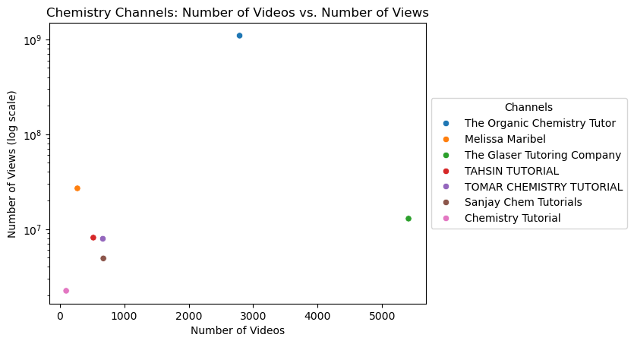
Are Num of Views and Num of Videos Correlated?
Seems num of videos and views are weakly correlated (R= 0.2955).
Need statistical testing to confirm whether weak correlation is significant or by chance.
Another good metric to assess would be date that the channel started.
Do those channels that have been around longer = have more views and subscribers?

Slide 8
Part 2: Top Chemistry-Related Channel = The Organic Chemistry Tutor (“TOCT”

Slide 9
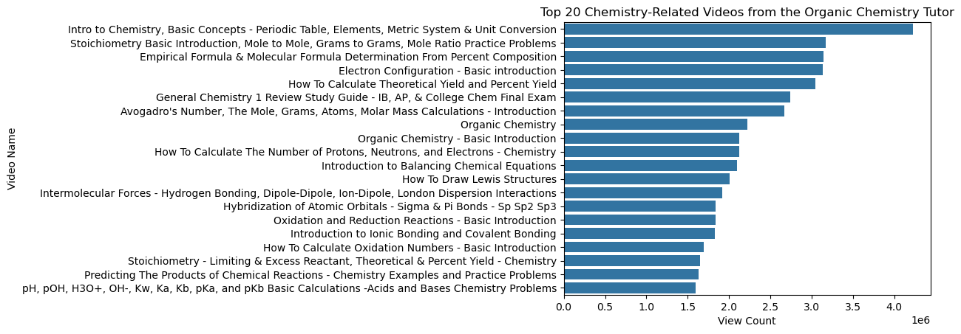
What are the Top 20 Videos by TOCT?
TOCT’s top video has ~1 million more views that the its second most popular video.
This video could be so popular because it goes over basic concepts that lay the foundation for chemistry.

Slide 10
What are the Top 20 Videos by TOCT? (cont’d)
After that, the most popular videos seem to be tutorials on the following topics:
Stoichiometry and Molar Calculations
Determining Empirical and Molecular Formulas
Electron Configurations
Calculating Theoretical Yield and Percent Yield
Predicting products of Chemical Reactions & Balancing subsequent Chemical Equations
Drawing Lewis Structures
Bonding: Ionic, Covalent, and Intermolecular Forces
Reduction-Oxidation Reactions
Basic Acid-Base Reaction Calculations
If I were to start my own channel: may be wise to create tutorials on similar foundational topics. This was my suspicion, but good to see.

Slide 11
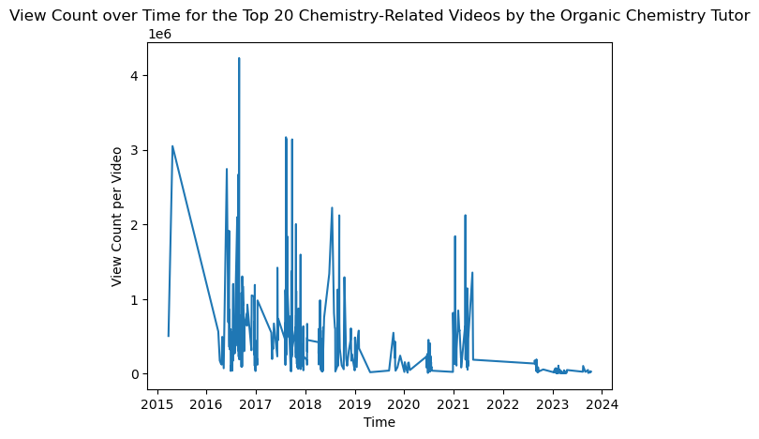
What is TOCT’s View Count over Time?
Video popularity = a cyclical pattern 2016-18: super popular videos to date each yr (2-4 mil views) before levelling out again (0.5-1 mil views)
2019 -2021, new videos have<1 mill views to date. Video views to date peak again for those published in 2021 (1.5-2 mil), but any videos published after that (2022-2023) have had consistently lower views (thousands).
Perhaps skyrocketing views related to COVID-19 pandemic: any videos published before 2020 = greater opp to skyrocket b/c greater need for them in 2020 and 2021.
The resurgence of new videos with views over a million happens again in 2021; I wonder if that's still COVID-19 related. Or perhaps it's the content he was putting out in 2021 - perhaps it was better than what he put out in 2020.

Slide 12
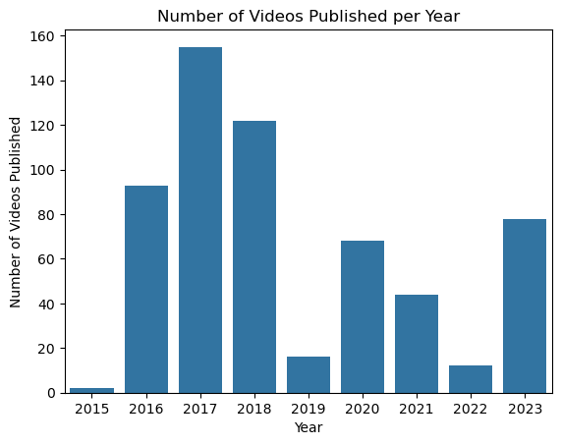
How many videos does TOCT post/year?
Most active years: 2016-2018 (90-160 videos/year)
Least active year: 2019 (<20)
More new videos again in 2020 and 2021 (40-80/yr).
2022: <20 and 2023: ~80
Maybe TOCT posted more videos again in 2020, because views for videos posted 2016-2018 took off during the pandemic (2020-21).
Perhaps TOCT was less interested in continuing channel after 2018 (hence few new videos in 2019), but the incentive of skyrocketing views (and therefore payouts for his content creation services) encouraged more videos in 2020 and 2021.
It would be interesting to see view counts for his 2016-2018 videos in 2019 (pre-covid). If views weren’t nearly as high as they are now to date, it would make sense why he felt less called to create content in 2019, then called again in 2020.

Slide 13
Conclusions
The Organic Chemistry Tutor = most successful Chemistry-related YT Channel by a lot.
Num of subscribers and num of views seem highly correlated (r=0.9997). Could perform statistical testing to verify the statistical significance, but I'd say it's not necessary.
Num of videos and num of views seem weakly correlated (r=0.2960). This suggests quality of videos = bigger influence on views than quantity. Could perform statistical testing, but this seems like a conclusion that checks out.
The Organic Chemistry Tutor's most popular videos are on foundational chemistry topics, which makes sense why they are so attractive.
The Organic Chemistry Tutor's most popular videos were published between 2016-2018. Perhaps onset of COVID-19 pandemic (2020) allowed for rise in views for these videos. Would be cool if we could access view count data from 2019.
Perhaps the impact of the pandemic on TOCT’s views may have encouraged him to post more content in 2020, after posting less in 2019. Perhaps incentive was there to keep his channel going, once TOCT realized how much money could continue to be made from the channel in the COVID era.

